Slide 1

싱글 플레이 예시
Team List-en 구자민

Slide 2
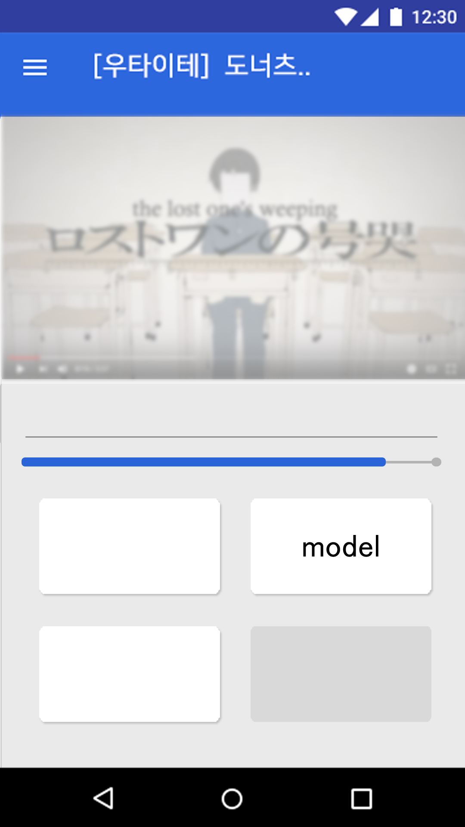

is
This
model
This
test
test
is

Slide 3
This
is
This
model
test
test
is

Slide 4
This is
is
This
model
test
test

Slide 5
This is test
is
This
model
test

Slide 6
This is test model
This
is
test

Slide 7
This is test model
is
of
our
This
test
test
project

Slide 8
This is test model
is
of
our
This
test
test
project

Slide 9
This is test model of
is
This
our
test
test
project

Slide 10
This is test model of our
This
is
test
test
project

Slide 11
This is test model of our project
This
is
test
test

Slide 12
is
This
model
This
test
test
is

Slide 13
…
요런 식으로 계속하면? .

Slide 14

is
This
model
This
test
test
is

